Slide 1


COFFEE SHOP SALES ANALYSIS
- SQL PROJECT

Slide 2
DATA PREPROCESSING
SYNTAX
SELECT * FROM coffee_schema.`coffee shop csv file`;
describe `coffee shop csv file`;
Change transaction date FROM TEXT TO DATE DATA-TYPE
Alter table coffee_schema.`coffee shop csv file`modify column transaction_date DATE;
-- format date -> Y/M/D
update coffee_schema.`coffee shop csv file`set transaction_date = date_format(transaction_date, '%Y-%m-%d’);
-CHANGE transaction_date FROM TEXT TO TIME DATA-TYPE
alter table coffee_schema.`coffee shop csv file`
modify column transaction_time TIME;
UPDATE `coffee shop csv file`
SET transaction_time = str_to_date(transaction_time, '%H-%i-%s’);
Rename column name
alter table coffee_schema.`coffee shop csv file`rename column ï»¿transaction_id to transaction_id;

Slide 3
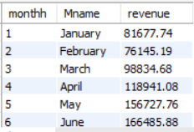
Q-1> calculate tot sales for each month
SYNTAX
select month(transaction_date)as monthh, date_format(transaction_date, '%M') as Mname, round(sum(transaction_qty*unit_price),2) as revenue from coffee_schema.`coffee shop csv file`group by 1,2;
ANSWER

Slide 4
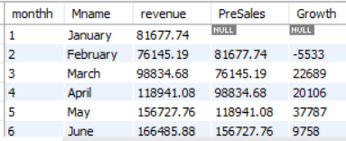
Q-2> Calculate sales difference between current &
Previous Month (MoM Growth)
SYNTAX
with A as (select month(transaction_date)as monthh, date_format(transaction_date, '%M') as Mname, round(sum(transaction_qty*unit_price),2) as revenue from coffee_schema.`coffee shop csv file`group by 1,2)select monthh, Mname, revenue, lag(revenue)over (order by monthh) as PreSales, round((revenue - lag(revenue)over (order by monthh)),0) as Growth from A ;
ANSWER

Slide 5
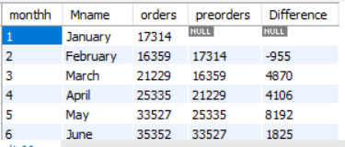
Q-3> Calculate total orders for each month ,
MoM order growth
SYNTAX
with a as ( select month(transaction_date)as monthh, date_format(transaction_date, '%M') as Mname, count(transaction_id) as orders from coffee_schema.`coffee shop csv file` group by 1,2 ) select monthh, Mname, orders, lag(orders) over (order by monthh) as preorders, (orders-lag(orders) over (order by monthh)) as Difference from a ;
ANSWER

Slide 6

Q-4> Sales Anaysis by weekend and weekdays
SYNTAX
with A as ( SELECT DAYOFWEEK(transaction_date) AS dayy, dayname(transaction_date) AS dayname, month(transaction_date) as monthh, case when dayname(transaction_date) in ('Sunday', 'Saturday') then 'weekend' else 'weekday' end as daytype, ROUND(SUM(transaction_qty * unit_price), 2) AS total_amount, COUNT(transaction_id) as Total_orders , sum(transaction_qty) as Total_Qty FROM coffee_schema.`coffee shop csv file`GROUP BY 1,2, 3, 4)select round(sum(total_amount),2), sum(Total_orders), sum(Total_Qty), daytype from A where monthh = 6 group by 4;
ANSWER

Slide 7
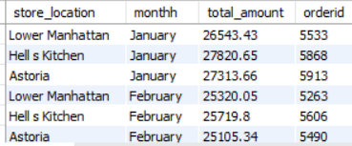
Q-5> Sales Analysis by store location
SYNTAX
select store_location,
monthname(transaction_date) monthh, ROUND(SUM(transaction_qty * unit_price), 2)
AS total_amount , count(transaction_id) ordered from coffee_schema.`coffee shop csv file`
group by 1,2;
ANSWER

Slide 8
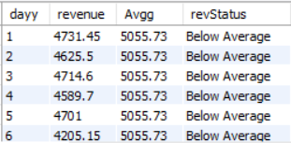
Q-6> Daily sales Analysis with Average line
SYNTAX
with B as (
with A as (
select day(transaction_date) as dayy, month(transaction_date) as monthh, ROUND(SUM(transaction_qty * unit_price), 2) AS revenue from coffee_schema.`coffee shop csv file`where month(transaction_date) = 5group by 1,2)
select dayy, revenue, round(avg(revenue) over (partition by monthh),2) as Avgg from A)
select *,case when revenue > Avgg then 'Above Average' else 'Below Average' end as revStatus from B;
ANSWER

Slide 9
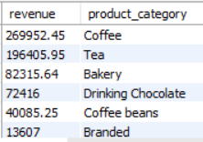
Q-7> Find sales by category
SYNTAX
select ROUND(SUM(transaction_qty * unit_price), 2) AS revenue,
product_category from coffee_schema.`coffee shop csv file`
group by 2
order by 1 desc;
ANSWER

Slide 10
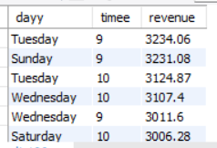
Q-8> Sales Analysis by Days and Hours
SYNTAX
select dayname(transaction_date) as dayy, hour(transaction_time) as timee, ROUND(SUM(transaction_qty * unit_price), 2) AS revenuefrom coffee_schema.`coffee shop csv file`where month(transaction_date) = 5group by 1,2order by revenue desclimit 10;
ANSWER

